Slide 1
P4: Programming Protocol-Independent Packet Processors
2026 Distributed and Parallel Computing
Hongik University, Department of Software and Communications Engineering.
Lan Anh, Nguyen
Bosshart, Pat, et al. "P4: Programming protocol-independent packet processors." ACM SIGCOMM Computer Communication Review 44.3 (2014): 87-95.

Slide 2
Contents
Motivation and Overview
P4 Explanation

Slide 3
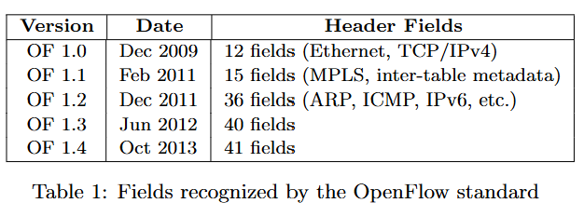
1
Motivation & Overview
Why P4? Limitation of traditional SDN (OpenFlow)
Problem: SDN controllers can install forwarding rules, but traditional switches still expose fixed packet-processing capabilities by protocol specifications and HW capability.
Fixed protocol-aware parsers
Growing OpenFlow header-field specifications
Vendor-specific, low-level switch programming
Limited portability across hardware targets
Causes:
            Limmited flexibility
            Increasing complexity
            Limited hardware independence

Slide 4
1
Motivation & Overview
P4 Overview
P4 (Programming Protocol-Independent Packet Processors):
high-level language for programming protocol-independent packet processor ~ Language to configure switches
Programmable packet parsing
Protocol-independent match-action processing
Flexible forwarding architecture
High-level language with target-specific compilation
P4 provides:
Reconfigurability
Change packet-processing behavior after deployment
Define new packet formats and processing logic.
Protocol independence
Express behavior without coding for one specific switch.
HW independence

Slide 5
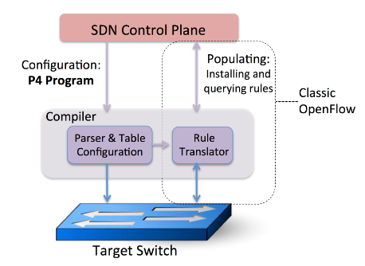
1
Motivation & Overview
P4 Overview
Two distinct interactions with switches:
Configure (P4): Define the packet processing capabilities via:
Parser
Define headers
Tables
Actions
Pipelines
Populate (OpenFlow): Install, update, remove table entries
Figure 1. P4 language to configure switches

Slide 6
1
Motivation & Overview
P4 Overview
P4 vs OpenFlow
P4=configure: Defines how packets can be processed ~ the pipeline
OpenFlow=populate: Defines which forwarding rules are applied ~ Table entries
Table 2. P4 vs OpenFlow
 | P4 | OpenFlow
Purpose | Program packet-processing | Manage forwarding rules
SDN role | Data-plane programming language | Control-plane protocol
Packet parsing | Prorammable, custom headers | Predefined protocol headers
Match-action tables | Defines tables, keys, actions | Installs, updates, removes table entries
HW independence | Compiler-based target independence | Standardized switch control interface

Slide 7
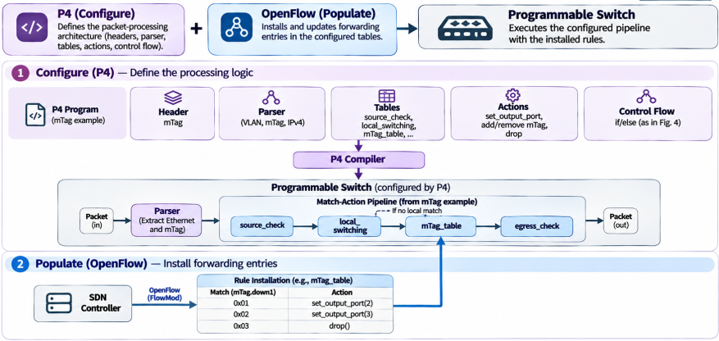
1
Motivation & Overview
P4 Overview
P4 vs OpenFlow
Figure 2. P4 and OpenFlow comparison

Slide 8
1
Motivation & Overview
P4
2.1. Abstract forwarding model
Model for packet processing using a programmable parser and configurable match-action stages
Defines the logical packet-processing architecture
What can be programmed with P4?
2.2. P4 programming language and example
A high-level language for defining headers, parsers, tables, actions, and control flow
Describes a particular forwarding behavior using five constructs
How is it described?
P4 programming toolchain = P4 proram + Compiler
2.3. P4 compiler
Translates the program into a target-specific configuration
How is it implemented?

Slide 9
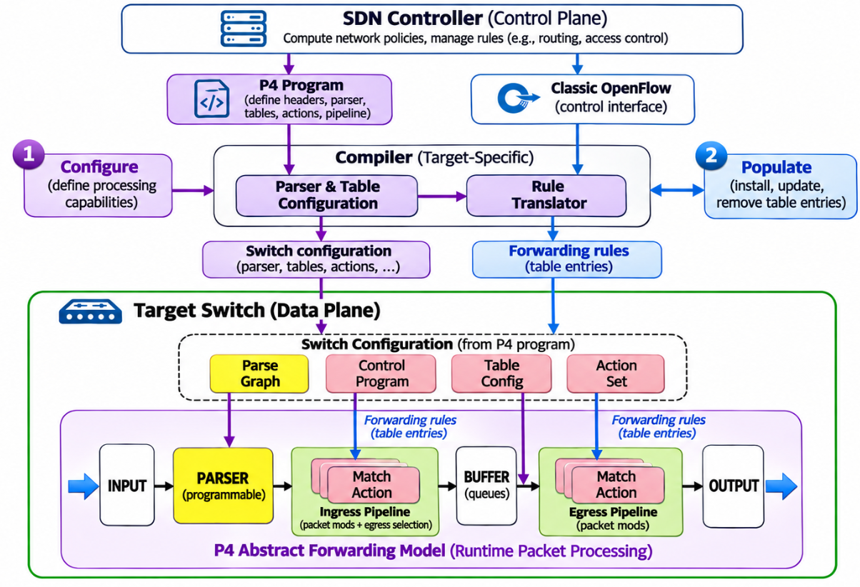
2
P4
2.1. P4 abstract forwarding model (AFM)
Three design principles in AFM:
1. Programmable parsing:
The switch does not need to assume one fixed set of packet headers. A parser graph describes which headers can appear, how they are recognized, and which fields should be extracted.
2. Flexible match-action processing:
The extracted fields and metadata are processed by logical match-action tables. Their organization may be sequential, parallel, or a combination, rather than one fixed pipeline.
3. Separation of configuration and population:
P4 defines the switch’s processing structure and actions, while the controller installs forwarding rules, separating switch programmability from forwarding policy management.
Figure 3. P4 abstract forwarding model

Slide 10
2
P4
2.1. P4 abstract forwarding model (AFM)
AFM splits programmable switch into 2 parts:
1. Switch configuration: Defines the parser, tables, actions, and processing dependencies
2. Runtime packet processing: Processes incoming packets according to that configuration and the installed forwarding rules
Table 3. Components in switch configuration
Components | Roles
Parse graph | Defines valid header sequences and parser transitions to extract headers and metadata
Control program | Specifies table execution order and conditional dependencies
Table configuration | Defines match fields, match types, and table structure
Action set | Defines available packet-processing operations
Figure 3. P4 abstract forwarding model

Slide 11
2
P4
2.1. P4 abstract forwarding model (AFM)
Steps in runtime packet processing:
Input: Receive packet
Parser: Extract headers and metadata
Ingress match-action: Make forwarding decisions and modify packets
Buffer: Queue packets for transmission
Egress match-action: Perform output-specific processing
Output: Transmit packet through output port
Figure 3. P4 abstract forwarding model

Slide 12
2
P4
2.2. P4 programming language
P4 programming toolchain = P4 proram + Compiler
To describe components in AFM, P4 language provides key features:
Protocol independence
Reconfigurability
Target independence
Match-action abstraction
Explicit control flow
To do that, P4 introduces five core constructs:
Table 4. Five constructs in P4
Constructs | Roles
Header | Define packet header formats and fields
Parser | Specify how headers are recognized and extracted
Table | Define match keys, match types, and available actions
Action | Define operations performed on packet fields or metadata
Control flow | Specify which tables execute and in what order

Slide 13
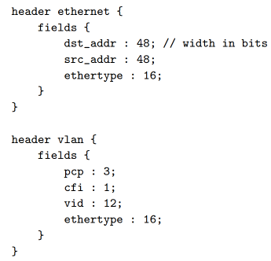
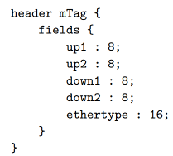
2
P4
2.2. P4 programming language
1. Header: An ordered collection of named fields
Ethernet: Defines src, dest MAC
Vlan: VLAN ID and priority
mTag: Hierarchical rounting labels

Slide 14
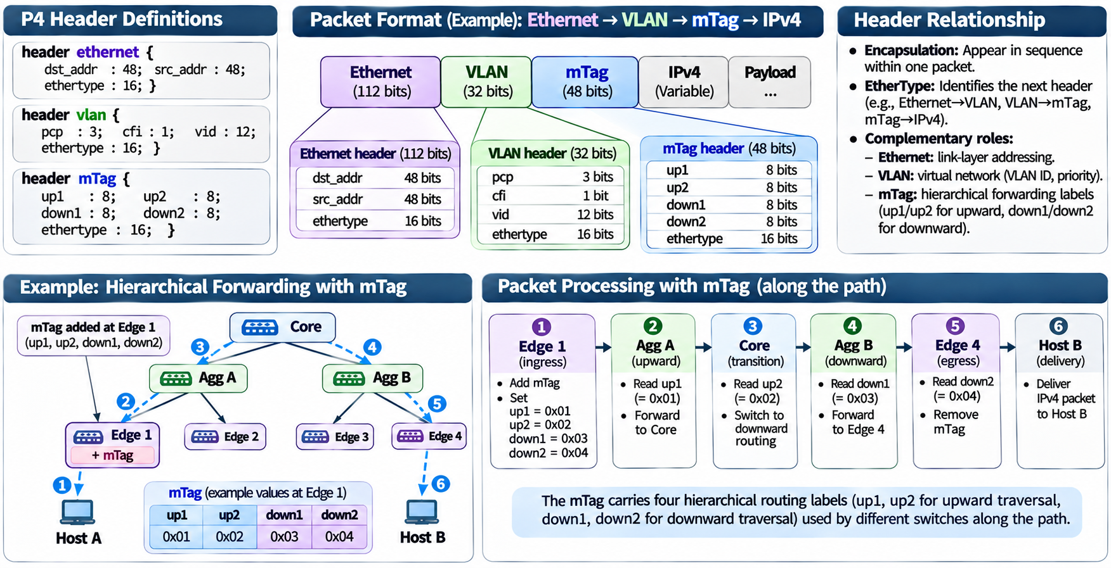
2
P4
2.2. P4 programming language
1. Header: Example

Slide 15
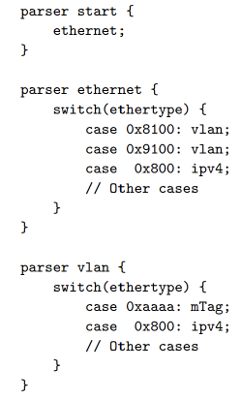
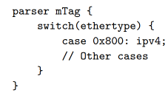
2
P4
2.2. P4 programming language
2. Parser: identifies packet headers, extracts their fields, and determines which header to process next
A parser works as a finite state machine (FSM) = (Extract, select, transition)
Extract: mTag header;
Select: ethertype value;
Transition: ethertype = 0x800, move to ipv4 parser state

Slide 16
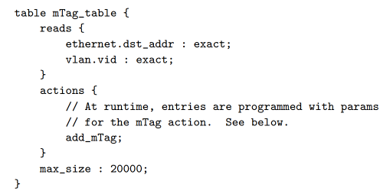
2
P4
2.2. P4 programming language
3. Table: A match-action table determines which action should be executed based on extracted packet header fields. A table with three main components:
Read: Which packet fields to examine
Action: Which operations the table can execute
Size: Maximum number of entries supported by the table
Reads: Installed MAC destination address and vlan ID;
Actions: Add an mTag header;
Size: 20000

Slide 17
2
P4
2.2. P4 programming language
4. Action: Defines the operations performed on a packet after a match-action table selects a matching entry. Action can be classified into:
Modify header fields
Insert or remove headers
Update metadata
Specify forwarding behavior
Action is constructed with 3 components:
Action name: Identifies the operation
Parameters: Values supplied by the matching table entry
Primitive operations: Instructions executed to modify the packet or metadata
  Add_header
  Set_field
  Etc.

Slide 18
2
P4
2.2. P4 programming language
4. Action: Example
action add_mTag(up1, up2, down1, down2) {
add_header(mTag);
modify_field(mTag.up1, up1);
modify_field(mTag.up2, up2);
modify_field(mTag.down1, down1);
modify_field(mTag.down2, down2);
modify_field(vlan.ethertype, 0xaaaa);
}
Action name: add_mTag;
Parameters: up1, up2, down1, down2;
Operations: add_header; modify_field;

Slide 19
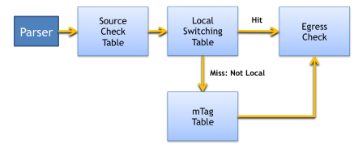
2
P4
2.2. P4 programming language
5. Control flow: Determines which match-action tables are executed, in what order, and under which conditions.
control main() {
// Step 1: Verify mTag state and ingress port
table(source_check);
// Step 2: Continue if no ingress error
if (!defined(metadata.ingress_error)) {
// Step 3: Attempt local forwarding
table(local_switching);
// Step 4: If not local, try mTag forwarding
if (!defined(metadata.egress_spec)) {
table(mTag_table);
}
// Step 5: Validate egress state
table(egress_check);
}
}
Figure 4. Control flow example

Slide 20
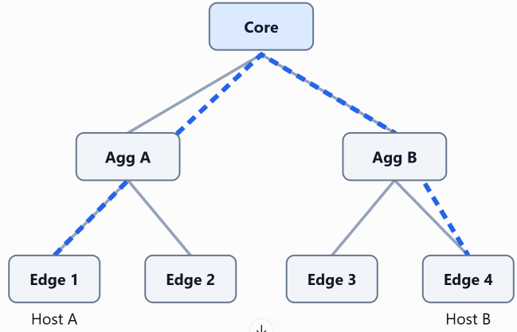
2
P4
2.2. P4 programming language
Example: mTag-Based Hierarchical Packet Forwarding (customize forwarding protocol in a hierarchical data-center network)
Network scenario:
Packet follows: Host A → Edge 1 → Agg A → Core → Agg B → Edge 4 → Host B
Edge 1:
Receives packet from Host A
We will use P4 programming to customize packet for forwarding
Figure 5. Network scenario example

Slide 21
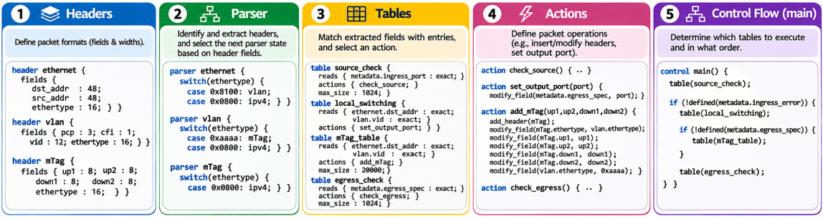
2
P4
2.2. P4 programming language
Example: mTag-Based Hierarchical Packet Forwarding (customize forwarding protocol in a hierarchical data-center network)
P4 struct programming:
Figure 6. P4 construct for example

Slide 22
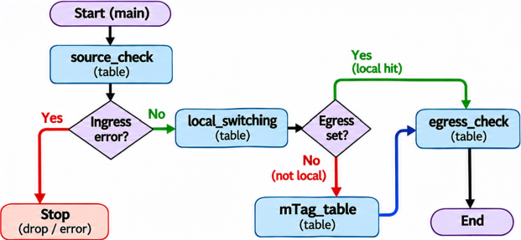
2
P4
2.2. P4 programming language
Example: mTag-Based Hierarchical Packet Forwarding (customize forwarding protocol in a hierarchical data-center network)
P4 construct programming: Control flow
Figure 7. Control flow in example

Slide 23
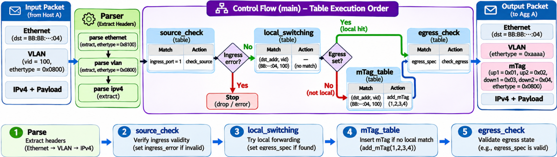
2
P4
2.2. P4 programming language
Example: mTag-Based Hierarchical Packet Forwarding (customize forwarding protocol in a hierarchical data-center network)
Figure 8. End-to-end packet processing with P4

Slide 24
2
P4
2.3. P4 compiler
P4 compiler: Translates a P4 program into a configuration/implementation suitable for a particular switch architecture.
It performs three tasks:
Parser compilation:
Converts header definitions and parser into hardware compatible parsing states.
Control compilation:
Analyzes match-action tables, actions, and execution dependencies.
Target mapping:
Assigns the resulting operations to the available hardware resources.

Slide 25
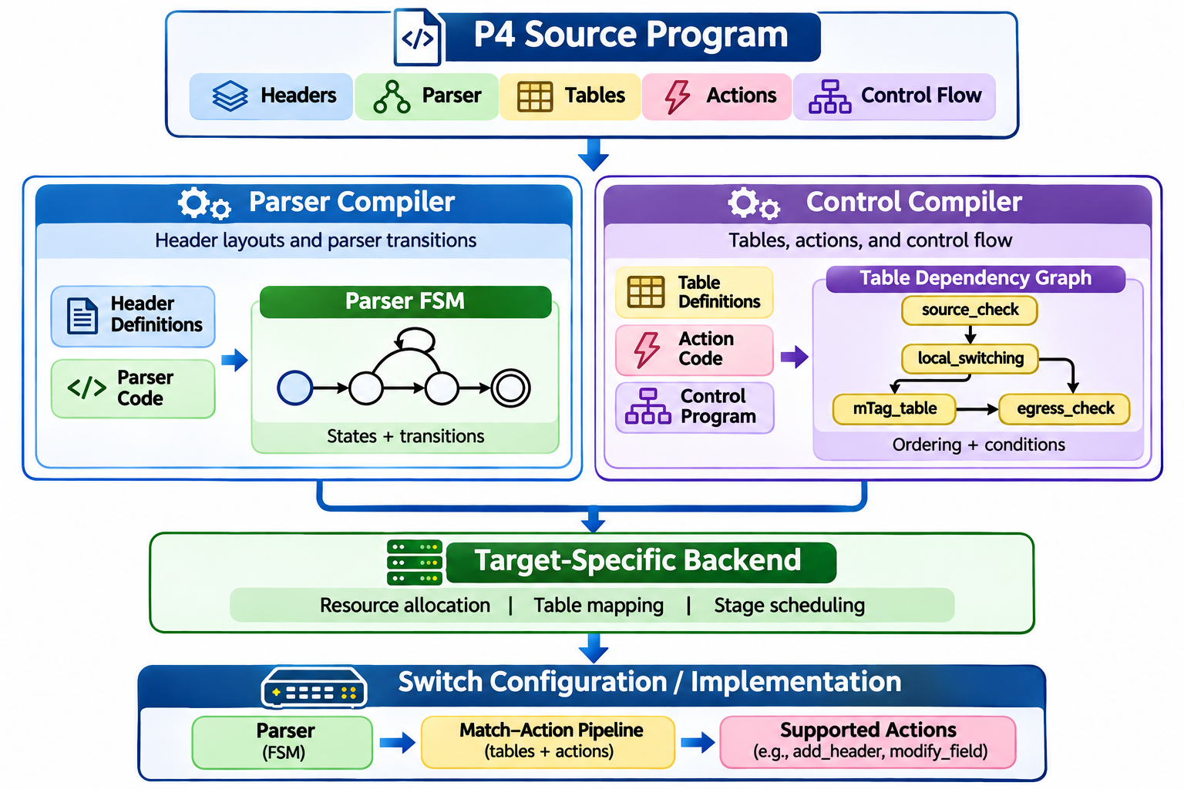
2
P4
2.3. P4 compiler
P4 compiler: Translates a P4 program into a configuration/implementation suitable for a particular switch architecture.
Figure 9. P4 compilation

Slide 26
Q&A
Thank You

